Slide 1
C++ programming II
Chapter 15: OOP

Slide 2
What is OOP?
OOP stands for Object-Oriented Programming.
Procedural programming is about writing procedures or functions that perform operations on the data, while object-oriented programming is about creating objects that contain both data and functions.
Object-oriented programming has several advantages over procedural programming:

Slide 3
OOP is faster and easier to execute
OOP provides a clear structure for the programs
OOP helps to keep the C++ code DRY "Don't Repeat Yourself", and makes the code easier to maintain, modify and debug
OOP makes it possible to create full reusable applications with less code and shorter development time
Tip: The "Don't Repeat Yourself" (DRY) principle is about reducing the repetition of code. You should extract out the codes that are common for the application, and place them at a single place and reuse them instead of repeating it.

Slide 4
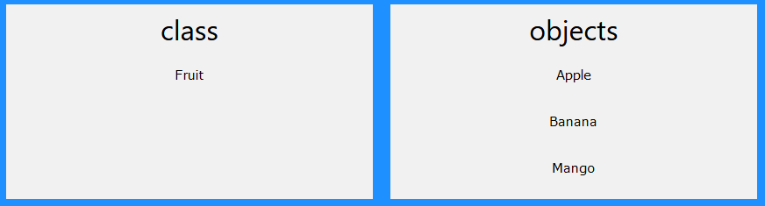
What are Classes and Objects?
Classes and objects are the two main aspects of object-oriented programming.
Look at the following illustration to see the difference between class and objects:

Slide 5
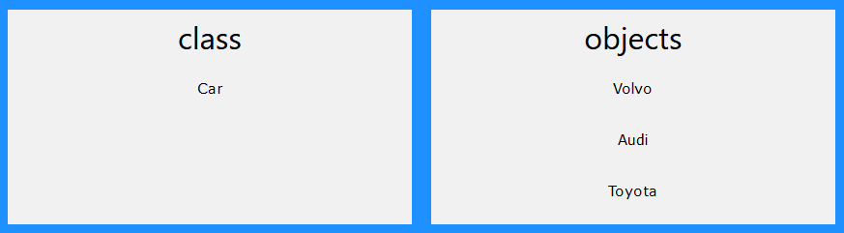
Another example:
So, a class is a template for objects, and an object is an instance of a class.
When the individual objects are created, they inherit all the variables and functions from the class.
You will learn much more about classes and objects in the next slides.

Slide 6
Classes/Objects
C++ is an object-oriented programming language.
Everything in C++ is associated with classes and objects, along with its attributes and methods. For example: in real life, a car is an object. The car has attributes, such as weight and color, and methods, such as drive and brake.
Attributes and methods are basically variables and functions that belongs to the class. These are often referred to as "class members".
A class is a user-defined data type that we can use in our program, and it works as an object constructor, or a "blueprint" for creating objects.

Slide 7
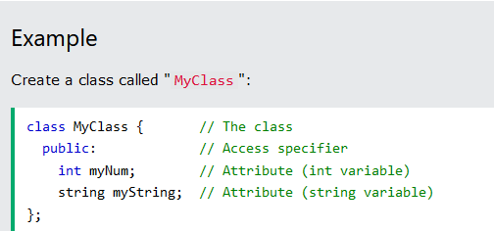
Create a Class
To create a class, use the class keyword.

Slide 8
Create an Object
In C++, an object is created from a class. We have already created the class named Myclass, so now we can use this to create objects.
To create an object of Myclass, specify the class name, followed by the object name.
To access the class attributes (myNum and myString) use the dot syntax ( . ) on the object:

Slide 9
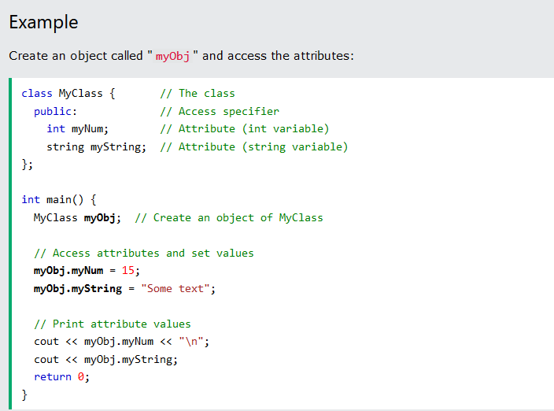

Slide 10
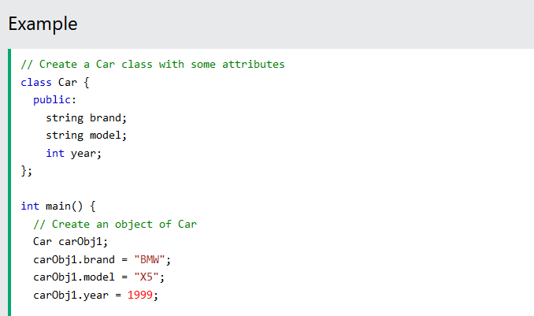
Multiple Objects

Slide 11
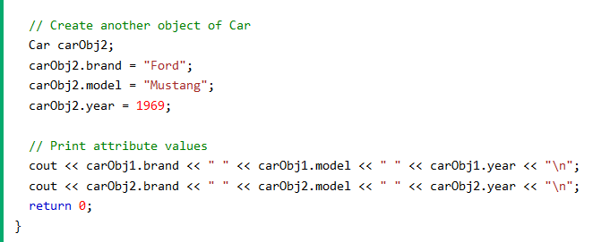

Slide 12
Class Methods
Methods are functions that belongs to the class.
There are two ways to define functions that belongs to a class:
Inside class definition
Outside class definition
In the following example, we define a function inside the class, and we name it “myMethod”.
Note: You access methods just like you access attributes; by creating an object of the class and using the dot syntax ( . ):

Slide 13
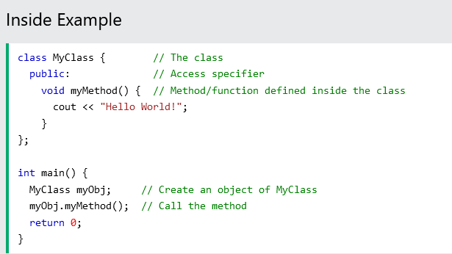

Slide 14
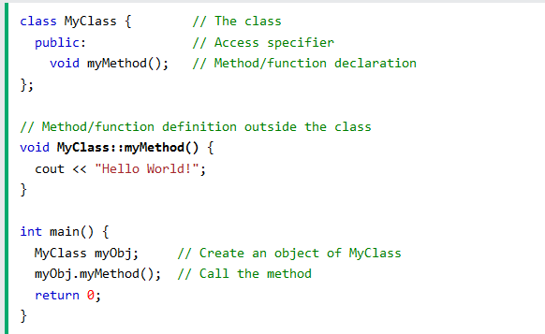
To define a function outside the class definition, you have to declare it inside the class and then define it outside of the class. This is done by specifying the name of the class, followed the scope resolution :: operator followed by the name of the function:

Slide 15
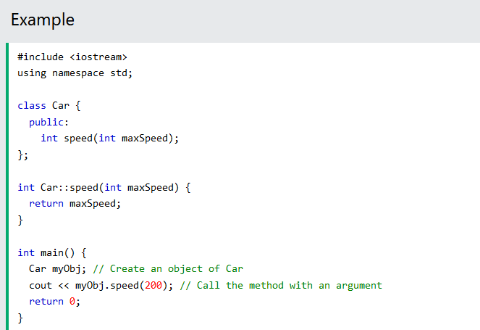
Parameters

Slide 16
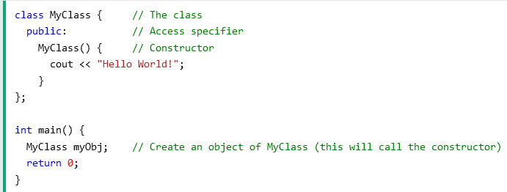
Constructors
A constructor in C++ is a special method that is automatically called when an object of a class is created.
To create a constructor, use the same name as the class, followed by parentheses ( ).

Slide 17
Constructor Parameters
Constructors can also take parameters (just like regular functions), which can be useful for setting initial values for attributes.
The following class have​​ brand, model, and year attributes, and a constructor with different parameters. Inside the constructor we set the attributes equal to the constructor parameters (brand = x, etc). When we call the constructor (by creating an object of the class), we pass parameters to the constructor, which will set the value of the corresponding attributes to the same:

Slide 18
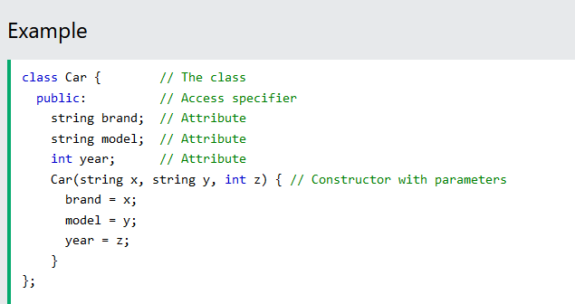

Slide 19
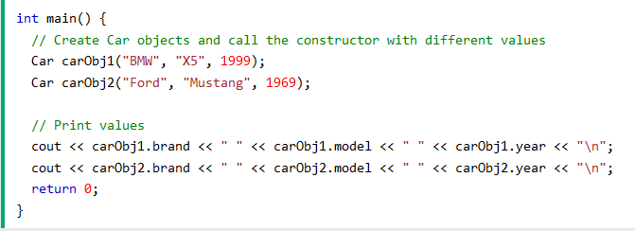

Slide 20
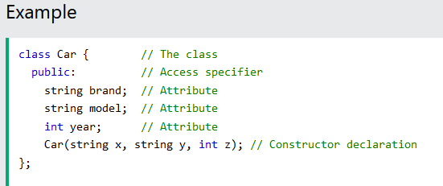
Just like functions, constructors can also be defined outside the class. First, declare the constructor inside the class, and then define it outside of the class by specifying the name of the class, followed by the scope resolution :: operator, followed by the name of the constructor (which is the same as the class):

Slide 21
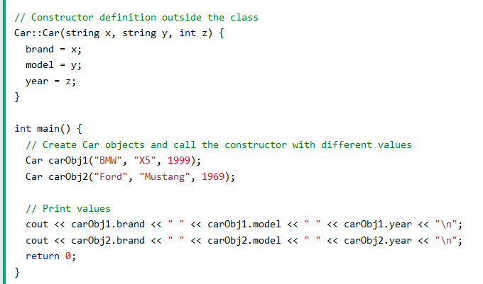

Slide 22
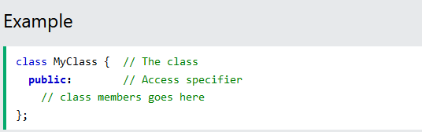
Access Specifiers
By now, you are quite familiar with the public keyword that appears in all of our class examples:

Slide 23
The public keyword is an access specifier. Access specifiers define how the members (attributes and methods) of a class can be accessed. In the example above, the members are public - which means that they can be accessed and modified from outside the code.
However, what if we want members to be private and hidden from the outside world?
In C++, there are three access specifiers:
public - members are accessible from outside the class
private - members cannot be accessed (or viewed) from outside the class
protected - members cannot be accessed from outside the class, however, they can be accessed in inherited classes.

Slide 24
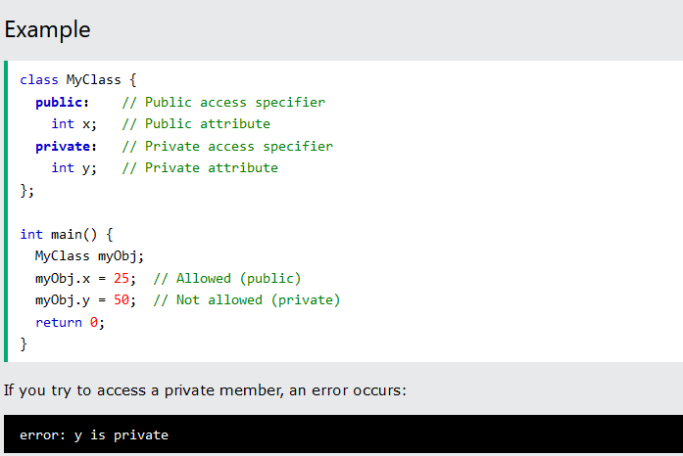

Slide 25
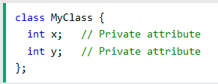
Note: It is possible to access private members of a class using a public method inside the same class. See the next chapter (Encapsulation) on how to do this.
Tip: It is considered good practice to declare your class attributes as private (as often as you can). This will reduce the possibility of yourself (or others) to mess up the code. This is also the main ingredient of the Encapsulation concept, which you will learn more about in the next chapter.
Note: By default, all members of a class are private if you don't specify an access specifier:

Slide 26
Encapsulation
The meaning of Encapsulation, is to make sure that "sensitive" data is hidden from users. To achieve this, you must declare class variables/attributes as private (cannot be accessed from outside the class). If you want others to read or modify the value of a private member, you can provide public get and set methods.

Slide 27
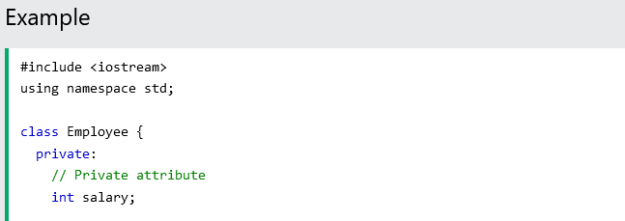
Access Private Members
To access a private attribute, use public "get" and "set" methods:

Slide 28
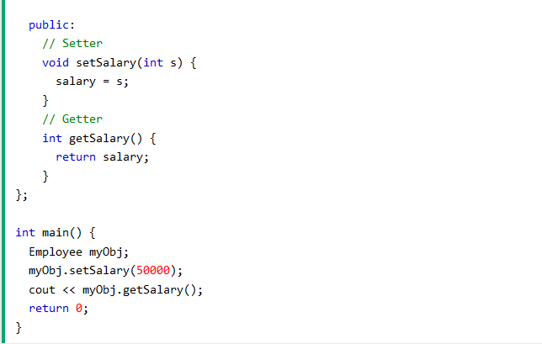

Slide 29
Example explained
The salary attribute is private, which have restricted access.
The public salary( ) method takes a parameter (s) and assigns it to the salary attribute (salary = s).
The public getSalary( ) method returns the value of the private salary attribute.
Inside main(), we create an object of the Employee class. Now we can use the setSalary( ) method to set the value of the private attribute to 50000. Then we call the getSalary( ) method on the object to return the value.

Slide 30
Why Encapsulation?
It is considered good practice to declare your class attributes as private (as often as you can). Encapsulation ensures better control of your data, because you (or others) can change one part of the code without affecting other parts
Increased security of data

Slide 31
Inheritance
In C++, it is possible to inherit attributes and methods from one class to another. We group the "inheritance concept" into two categories:
derived class (child) - the class that inherits from another class
base class (parent) - the class being inherited from
To inherit from a class, use the : symbol.
In the example below, the car class (child) inherits the attributes and methods from the Vehicle class (parent):

Slide 32
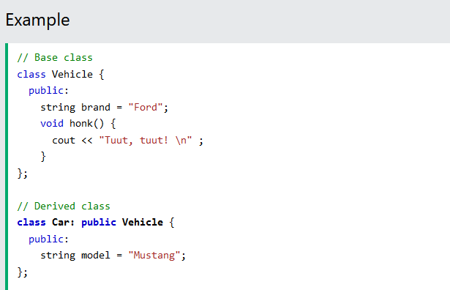

Slide 33
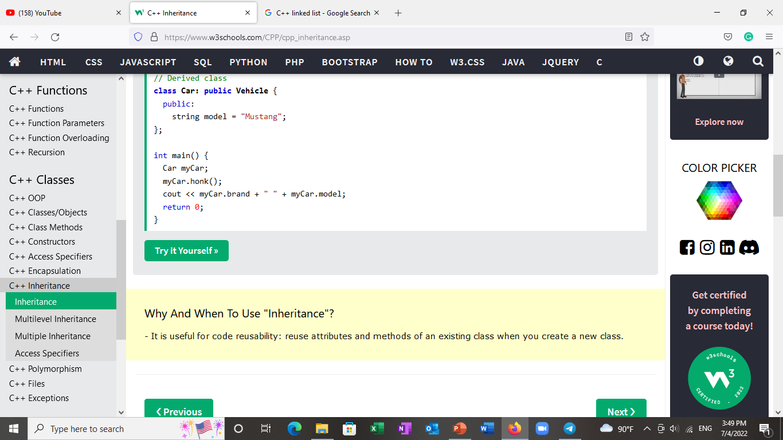
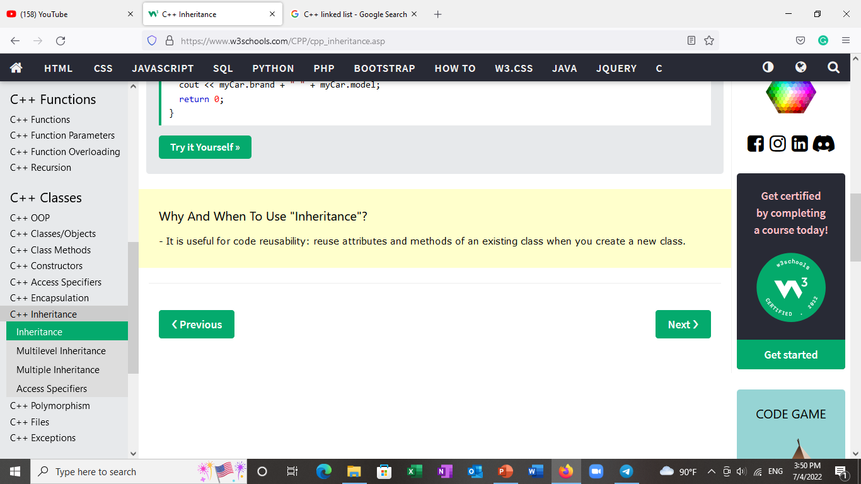

Slide 34
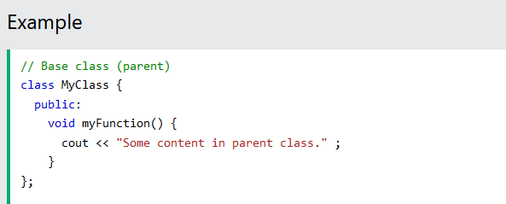
Multilevel Inheritance
A class can also be derived from one class, which is already derived from another class.
In the following example, MyGrandChild is derived from class (which is derived from Myclass).

Slide 35
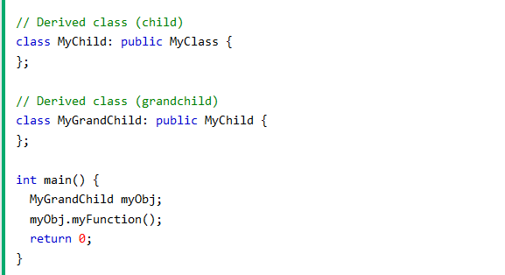

Slide 36
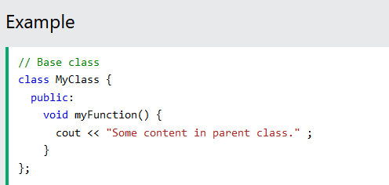
Multiple Inheritance
A class can also be derived from more than one base class, using a comma-separated list:

Slide 37
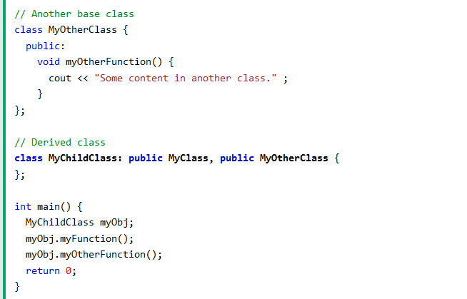

Slide 38
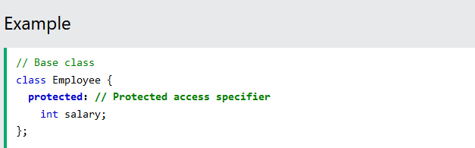
Access Specifiers
You learned from the Access Specifiers chapter that there are three specifiers available in C++. Until now, we have only used public (members of a class are accessible from outside the class) and private (members can only be accessed within the class). The third specifier, protected , is similar to private , but it can also be accessed in the inherited class:

Slide 39
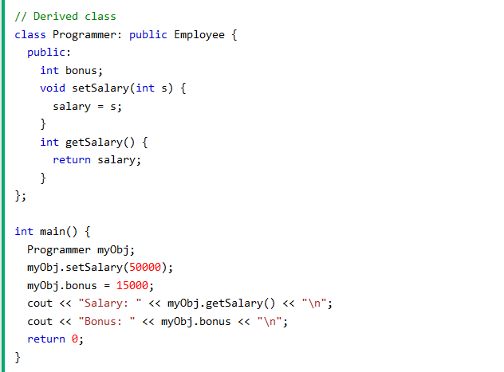

Slide 40
Polymorphism
Polymorphism means "many forms", and it occurs when we have many classes that are related to each other by inheritance.
Like we specified in the previous chapter; Inheritance lets us inherit attributes and methods from another class. Polymorphism uses those methods to perform different tasks. This allows us to perform a single action in different ways.
For example, think of a base class called Animal that has a method called animalsound(). Derived classes of Animals could be Pigs, Cats, Dogs, Birds - And they also have their own implementation of an animal sound (the pig oinks, and the cat meows, etc.):

Slide 41
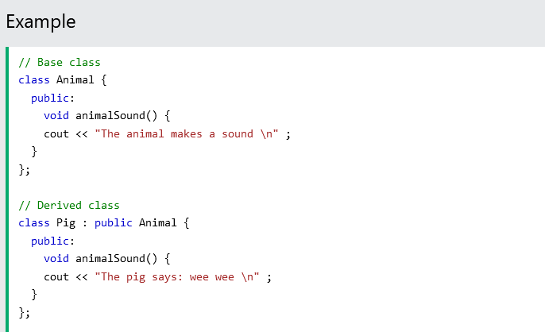

Slide 42
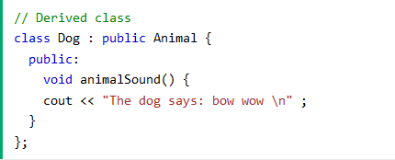
Remember from the Inheritance chapter that we use the : symbol to inherit from a class.
Now we can create​ Pic and Dog objects and override the​ animalSound( ) method:

Slide 43
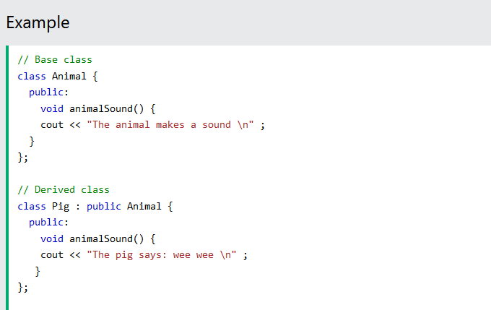

Slide 44
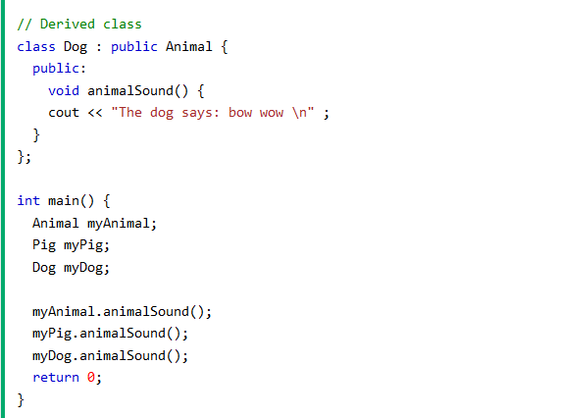
Why And When To Use "Inheritance" and "Polymorphism"?
- It is useful for code reusability: reuse attributes and methods of an existing class when you create a new class.

Slide 45
Exceptions
When executing C++ code, different errors can occur: coding errors made by the programmer, errors due to wrong input, or other unforeseeable things.
When an error occurs, C++ will normally stop and generate an error message. The technical term for this is: C++ will throw an exception (throw an error).

Slide 46
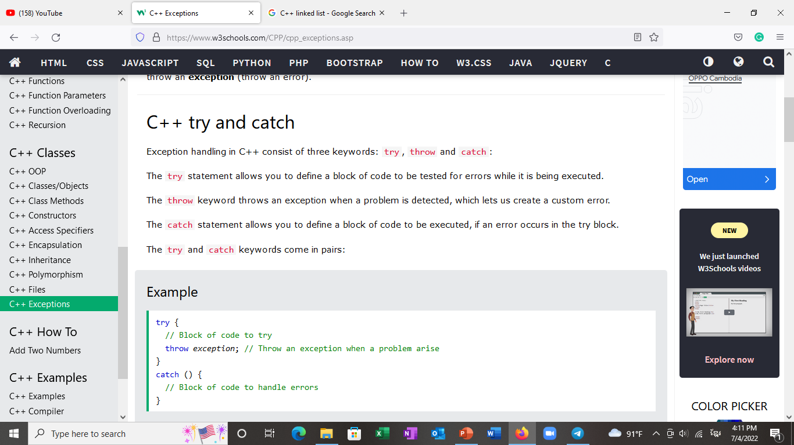
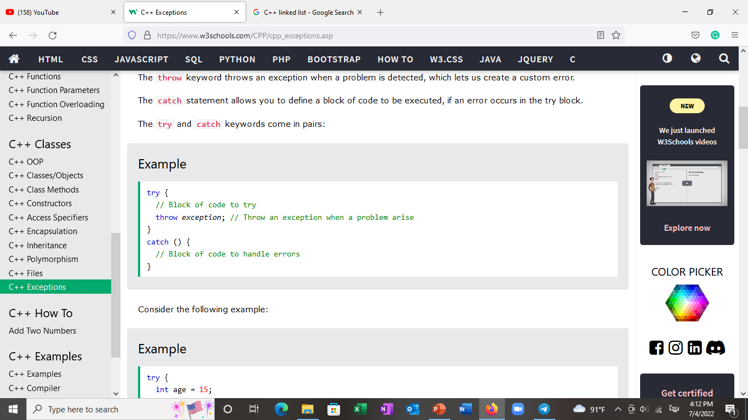

Slide 47
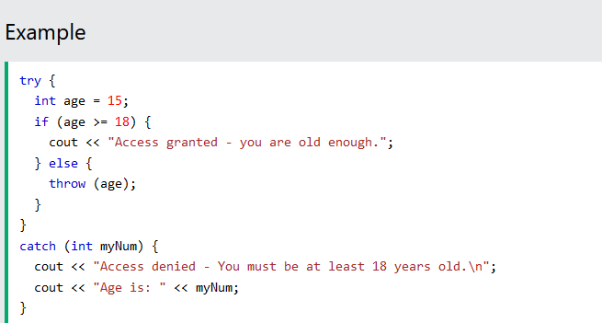

Slide 48
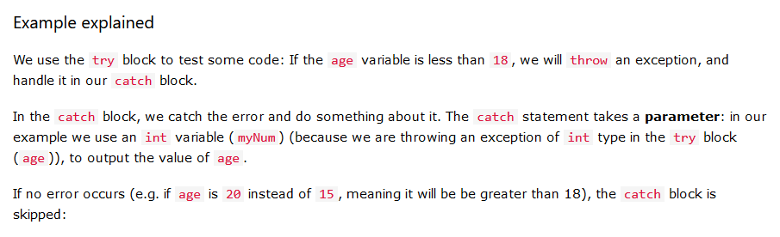
You can also use the throw keyword to output a reference number, like a custom error number/code for organizing purposes:

Slide 49
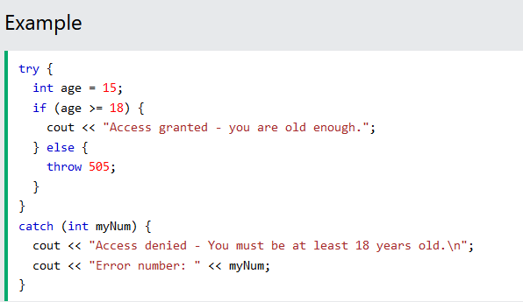

Slide 50
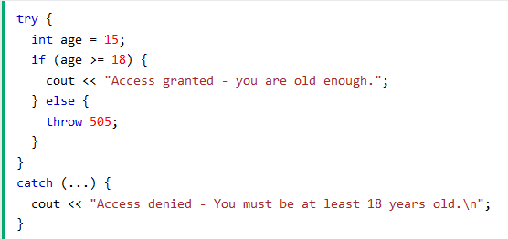
Handle Any Type of Exceptions (...)
If you do not know the throw type used in the try block, you can use the "three dots" syntax (…) inside the catch block, which will handle any type of exception:

